Slide 1

K.S.R. COLLEGE OF ENGINEERING (Autonomous) TIRUCHENGODE - 637 215
MODERN AIRBAG SYSTEM
Done by:
S. Moamed kalifa
Reg.No. 2013063
Department of CSE
Third year
Supervisor by
Dr. K. Kumaresan, AP
Department of CSE

Slide 2
Content
Introduction
Literature Review
Problem Statement
Objectives
Novelty of the Project
Block Diagram/Framework of the Project/Methodology
Components Specification
Outcome of the Project
Conclusion
References

Slide 3
Introduction
An air bag is an inflatable cushion designed to protect automobile occupants from serious injury in the case of a collision
Installation of airbag on front bumper of vehicle helps to reduces the vehicle collision in high velocity.
To reduce the recovering and rebuild cost of vehicle after vehicle collision.
Reduces the rise of hospitable and putting life out of rise

Slide 4
Literature Review
S. No | Title of The paper | Description | Publication details
1 | Ultrasonic Sensors | Ultrasonic sensors emit an acoustic weave between 20 hertz and 20 kilohertz and determine the distance. Ultrasonic sensors can be used in many fields. For instance, it can be used as parking assistance sensors in cars. | Publishers,Volume No.,Issue No.,Year of Publication
2 | Paper2 | Important points gathered from reference paper | Publishers,Volume No.,Issue No.,Year of Publication

Slide 5
Problem Statement
Indian government has banned the installation of the bull bars and crash guards on the front and the rear of all passenger vehicles.
During bumper to dumper collision the vehicle gets high damages in frames, engine, radiator and engine frames.

Slide 6
Bumper to bumper impact collisions are among the most dangerous type of road accidents, which account for nearly 700 deaths every year.

Slide 7
Objective
The modern airbag system which specified to reduce the bumper to bumper collision impact for passengers in vehicle.
Improve the pre-crash safety by reading the speed of opposite vehicle and distance during collision period.
To reduce the vehicle damages in engine frame , radiator, bonnet and cars frame.
It will pre alert the computer to inflated the airbag when it monitor a vehicle is on crash and active the radar sensor.

Slide 8
To increase crashing distance during accident.
Decreasing the response time of braking system.

Slide 9
Novelty Of The Project
First pre crash external airbag system at front side of vehicle
Smart airbag is a concept that consists of a computer which monitors the speed of opposite vehicle and distance where the airbag will deploy.
This airbag system is concept followed by pre crash external side airbag system to reduce the impact of passenger
This extra safety feature will provide an additional lateral crumple zone, which can help save lives and reduce occupant injuries by up to 40%.

Slide 10
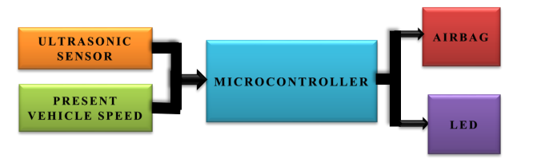
Block Diagram/Framework of the Project/Methodology
VEHICLE EXTERNAL AIRBAG SYSTEM

Slide 11
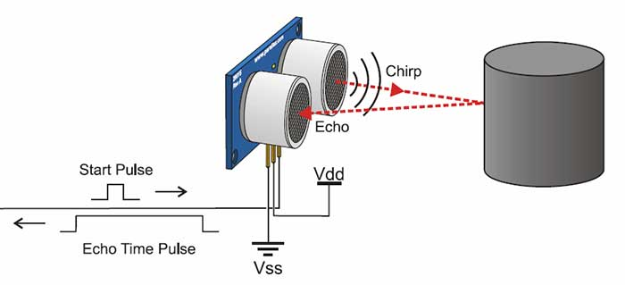
Ultrasonic sensor
An ultrasonic sensor is an electronic device that measures the distance of a target object by emitting ultrasonic sound waves, and converts the reflected sound into an electrical signal. Ultrasonic waves travel faster than the speed of audible sound (i.e. the sound that humans can hear).

Slide 12
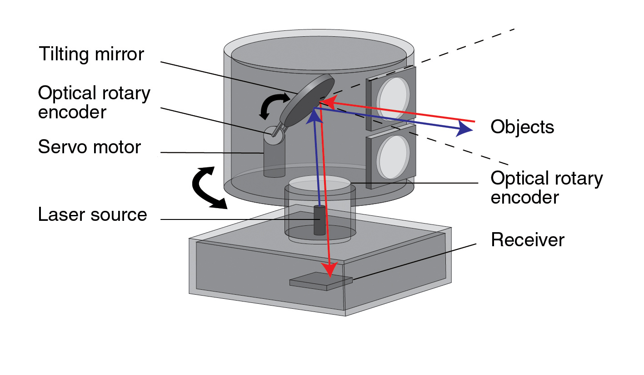
In this system the purpose of the sensor is to detect the presence of any object within 50 meters of range and send the corresponding signal to the microcontroller. Below shown is a working diagram of an ultrasonic sensor.
LiDAR Technology
Used to examine the surface of the earth, assess information about the ground surface, create a digital

Slide 13
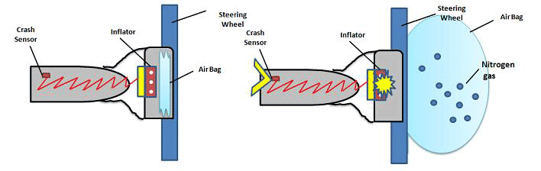
twin of an object or detail a range of geospatial information. Which helps to detector the vehicles are crossing while line in roads
Airbag:
These sensors respond to several different sets of stimuli, including sudden stopping, increased pressure as pieces of the car are moved due to the force of the collision, and more.

Slide 14
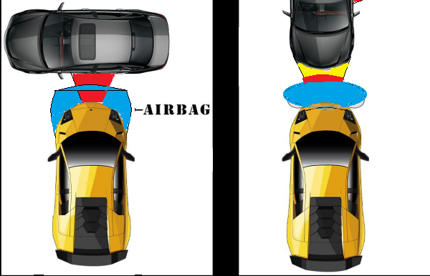
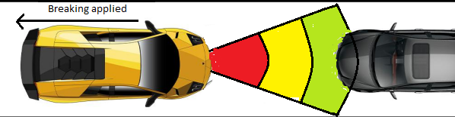
Working of pre-crash airbag in bumper :
Ultrasonic sensor reading the distance of object
Inflating of airbag during red alert

Slide 15
Components Specification
S.No | Name Of The Component | Technical Specification
1 | Radar sensors | They send out radio waves that detect objects and gauge their distance and speed in relation to the vehicle in real time.
2 | Ultrasonic sensor | which measures the distance of a target object by emitting ultrasonic sound waves, and converts the reflected sound into an electrical signal.
2 | Lidar sensors | Apart from measuring the distances to various objects on the road and gets 3D objects.
3 | Airbag | Fabric with high strength and thermal stability.
4 | Nitrogen gas | To create a huge air pressure in airbag.
5 | Crash sensors | To sense the crash and inflate the nitrogen gag.

Slide 16
Conclusion
The airbags provide safety to the occupants of cars and reduce the mortality even at 70%.
When not used in accordance with international standards can cause serious injuries and damage to vehicle
The airbags should always be used in conjunction with speed limits and seatbelts

Slide 17
Reference
https://www.designboom.com/technology/volvo-v40-helps-save-lives-with-pedestrian-airbags/
http://www.motoroids.com/news/volvo-and-uber-team-up-to-reveal-production-ready-self-driving-vehicle
https://www.haikudeck.com/airbags-education-presentation-SwhPZ2BMQq#slide8
https://korkortonline.se/en/theory/reaction-braking-stopping
htttps://users.encs.concordia.ca/~bwgordon/arduino_lab3.html

